Slide 1
In-Hospital Falls Prevention and Management
Train the trainer

Slide 2
To provide a comprehensive overview of falls risk, management of risk and falls prevention strategies as part of a multi-disciplinary approach
Aims

Slide 3
Recognise the importance of timely and effective assessment of falls risk
Develop an understanding of the multifactorial risks associated with falls
Understand and apply the falls risk bundle assessment and prevention measures
Be aware of the importance of multi-disciplinary support and interventions in the prevention of falls
Learning outcomes

Slide 4
Statistics and Health Priorities

Slide 5
‘The liability of old people to tumble and often injure themselves is such a commonplace of experience that it has been tacitly accepted as an inevitable aspect of ageing and thereby deprived of the exercise of curiosity.’
Joseph Sheldon, BMJ 1960
Notes:
As the young people would say.. In the mid 1900s!

Slide 6
Statistics
More than 6000 people in Scotland are admitted to hospital each year, with a hip fracture
(NHS 2023)
The Global Burden of Disease study reported nearly 17 million years of life lost from falls in 2017 (Montero-Odasso et al. 2022)
30% of people older than 65 and 50% of people older than 80 fall at least once a year (NICE 2013)
Falls remain a common cause of harm to patients in acute hospitals, with as many as 27,000 falls recorded in Scotland every year (Scottish Government 2019)
Notes:
Can we get some local stats?
**Scottish hip fracture audit 2023: More than 6000 people in Scotland are admitted to hospital each year.

Slide 7
National SPSP Inpatient falls reduction targets:
20% reduction in inpatient falls
30% reduction in inpatient falls with harm
SPSP Falls reduction
By March 2024
Falls | Scottish Patient Safety Programme (SPSP) | ihub - Falls

Slide 8
Why do we need training?
All healthcare professionals dealing with patients known to be at risk of falling should develop and maintain basic professional competence in falls assessment and prevention (NICE 2013)

Slide 9
Falls and why they happen

Slide 10
What is a fall?
A fall is an event which results in a person coming to rest inadvertently on the ground or floor or other lower level.
Falls, trips and slips can occur on one level or from a height (WHO, 2021)
Notes:
This includes syncopal events

Slide 11
Most people don’t stay in one position all the time,
So, why do people get up?
Tell me why you get up from your chair/bed

Slide 12
Why do people get up?
Need the toilet
Are hungry/thirsty
Are in pain/uncomfortable
Are bored
Hear a noise and think it’s the front door/phone/child/pet
Are frightened

Slide 13
Why do people fall?
Health
Medications
Environment
Everything Else!
Contributory Factors

Slide 14
QUIZ health associated falls risk factors
P---
H--r---
-y-s----
--zz-----
D--y---t---
-nf------
B--d-e- dys--------
--nst-----on
F--t c---
-st---or-s--

Slide 15
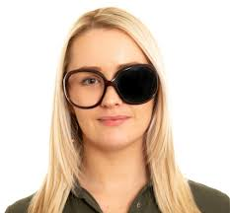
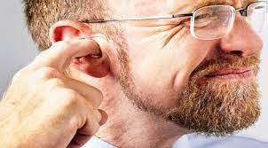
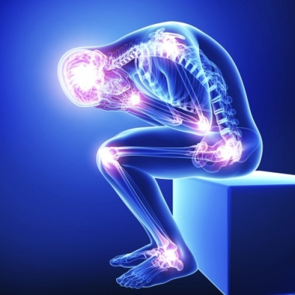
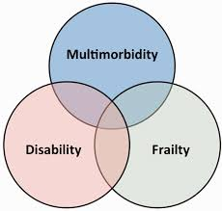
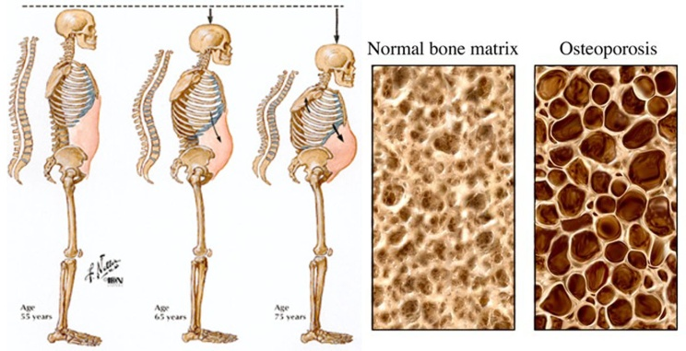
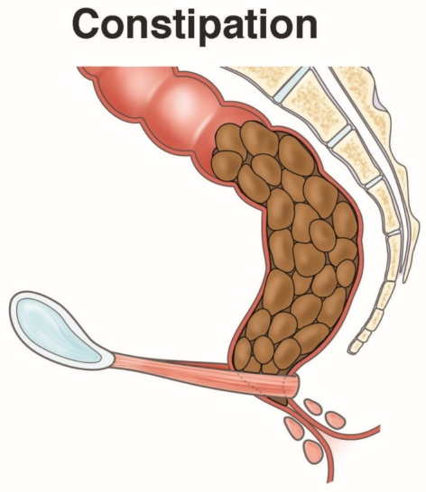
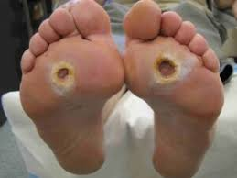
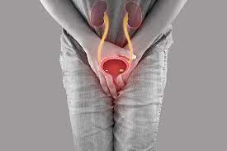
Health
Notes:
Eyesight (varifocals and bifocals can cause falls)
Pain (eg arthritis in joints or desire to relieve pressure)
Strength – weakness in muscles due to periods of immobility, frailty or a condition such as stroke, Parkinson's, MS, etc
Lack of sensation/too much sensation in feet
Dehydration
Infection eg UTI, chest infection
Confusion/delirium/dementia
Incontinence/urge incontinence
Constipation
Dizziness/blackouts/seizures
Poor hearing/blocked ears
Balance exercise

Slide 16
Medications
Too many medications (polypharmacy)
Certain types of medications
Notes:
Why do you think each of these have an effect?

Slide 17
Medications
Sedatives/hypnotics
diazepam, lorazepam, midazolam
Pain killers
opiates (morphine, oxycodone, codeine, fentanyl) or non-steroidal anti-inflammatory drugs (aspirin, ibruprofen, diclofenac)
atenolol, bisoprolol, metoprolol, spironolactone, candesartan, losartan, amlodipine, nifedipine, verapamil, doxazosin
Diuretics
furosemide, bumetanide
Medications for high blood pressure

Slide 18
Medications
Antidepressants with a sedating effect
amitriptyline, trazodone
Drugs for psychosis/agitation
haloperidol, risperidone, quetiapine
Antihistamines
certrazine, loratadine
Antimuscarinics (used for incontinence)
oxybutynin, tolterodine

Slide 19
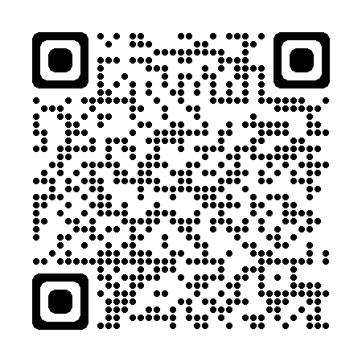
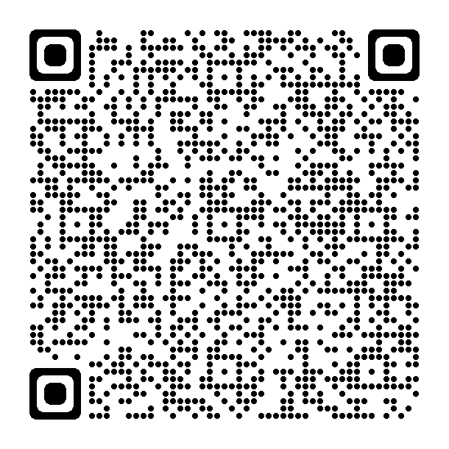
Environment
Games | Falls Assistant
Spot the Hazard Game | Injury Matters
Notes:
Can you think of any other environmental factors?
Lighting
Clutter
Inappropriate seating/mattresses/beds
Access to bath/shower
Flooring
Wet floor
Obstacles
Noise
Other people

Slide 20
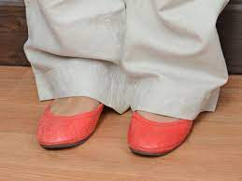
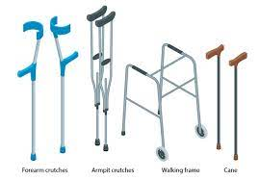
Everything else
Notes:
Can you think of anything else?
Badly fitting foot wear
Clothing that does not fit
Wrong walking aids

Slide 21
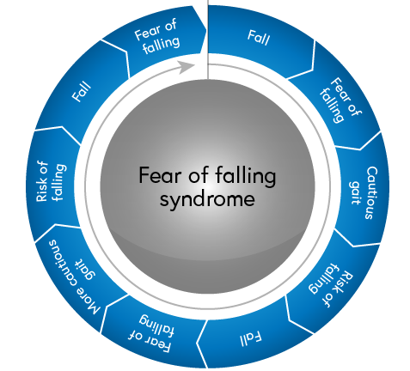
Everything else
Fear of falling...
This can be a predictor for falls however can sometimes provide a protective element
The biggest predictor for future falls is a previous fall
66% chance of another fall within a year of their first fall

Slide 22
Complexities of falls risk
Environment
Physical wellbeing
Mental health
Medication
Notes:
It is clear that the risk of falls within the hospital patient population is both high and complex
SO HOW DO WE reduce this complex risk?

Slide 23
Assessing Falls Risk

Slide 24
So, WHO is at risk?
NICE 2013 and WHO 2023 both state that all people over 65 in a hospital (or care environment) should be classed as at risk of falls
Notes:
Both global and national health organisations recognise the cost of falls on the person’s health and to the health industry

Slide 25
NICE Recommendations
Older people who present for medical attention because of a fall, or report recurrent falls in the past year, or demonstrate abnormalities of gait and/or balance should be offered a multifactorial falls risk assessment
This assessment should be performed by a healthcare professional with appropriate skills and experience, normally in the setting of a specialist falls service. This assessment should be part of an individualised, multifactorial intervention.
Notes:
(Split into two, and ‘treasure hunt’)?
As HCP we have a responsibility to reduce the risk of harm to our patients.
Assessing each person’s risk of falling is part of the person-centred risk assessment bundle and is expected to be completed within the first? (24 or 6) hours of admission.

Slide 26
The 5 Q’s Falls Risk Assessment (trak risk assessment)
Complete and document the screen for more vulnerable patients (5Qs)
(If answers ‘yes’ to any of the five questions below, the patient is identified
as ‘more vulnerable’.
Has the patient fallen in the last 6 months – including during this admission?
Does the patient have a 4AT greater than 0 or acute confusion (delirium)?
Does the patient attempt to walk alone although unsteady or unsafe?
Does the patient or their relative/s have fear or anxiety regarding falling?
Based on your clinical judgement, is this patient at high risk of falling?
Notes:
Read the slide

Slide 27
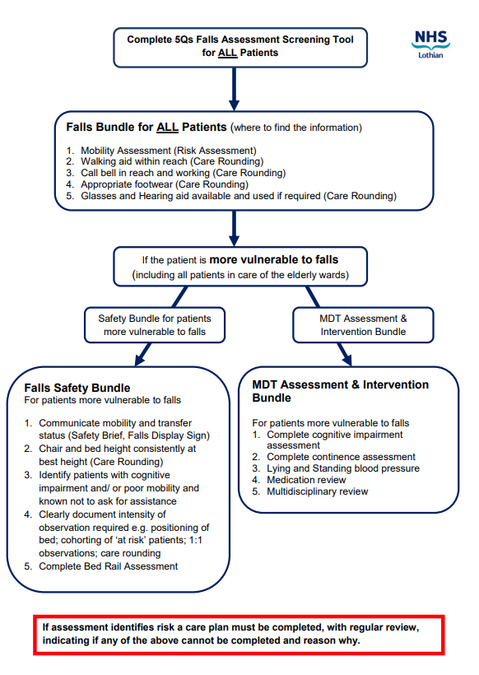
NHS Lothian Falls risk assessment flowchart
Notes:
Blank falls flowchart to
This is the process for assessing falls risk in NHS Lothian.
This is expected to be carried out with all patients, as per instructions
Lets break down the process...

Slide 28
Falls Bundle NHS Lothian
Mobility Assessment (Risk Assessment)
Walking aid within reach (Care Rounding)
Call bell in reach and working (Care Rounding)
Appropriate Footwear (Care Rounding)
Glasses and hearing aids available and used if required (Care Rounding)
Complete for ALL patients
Notes:
Falls assessment and prevention for all patients: aimed at optimising safety

Slide 29
Falls Safety Bundle for more vulnerable patients NHS Lothian
Communicate mobility and transfer status (Safety Brief, Falls Display Sign)
Chair and bed consistently at the best height (Care Rounding)
Identify patient with cognitive impairment and/or poor mobility and not known to ask for assistance
Clearly document intensity of observation needed e.g. Bed positioning, 1:1 observations, cohorting at risk patients, care rounding
Complete Bed Rail Assessment (Risk Assessment)
Complete for patients deemed at risk and all patients in medicine of the elderly wards
Notes:
Where the 5 questions risk assessment has flagged ‘YES’ this more vulnerable pt risk bundle signposts to basic falls prevention actions and should also include an MDT assessment see following slide

Slide 30
MDT Intervention and Assessment Bundle for more vulnerable patients NHS Lothian
Complete cognitive impairment assessment
Complete Bladder and Bowels assessment
Lying and standing blood pressure
Medication review
Multidisciplinary review
Complete for patients deemed at risk and all patients in medicine of the elderly wards
Notes:
The MDT assessment is where the individual’s contributory risks are determined and should include falls history, health conditions, mobility/balance problems, syncopal issues, visual impairment and fracture/osteoporosis risk.

Slide 31
Falls Risk Assessment
The Falls Risk Assessment should be commenced as soon as possible for all adult patients who are admitted to hospital and completed within 24 hours of admission.
This is especially important for those aged over 65
those with a history of falls or admitted due to a fall.
This is a simple 5 question assessment with any answer YES identifying the patient as more vulnerable to falls.
The falls risk assessment MUST be reviewed if the patient falls, their condition deteriorates or upon transfer to another ward.
This assessment should be reviewed weekly or sooner if deemed necessary (NHS Lothian)

Slide 32
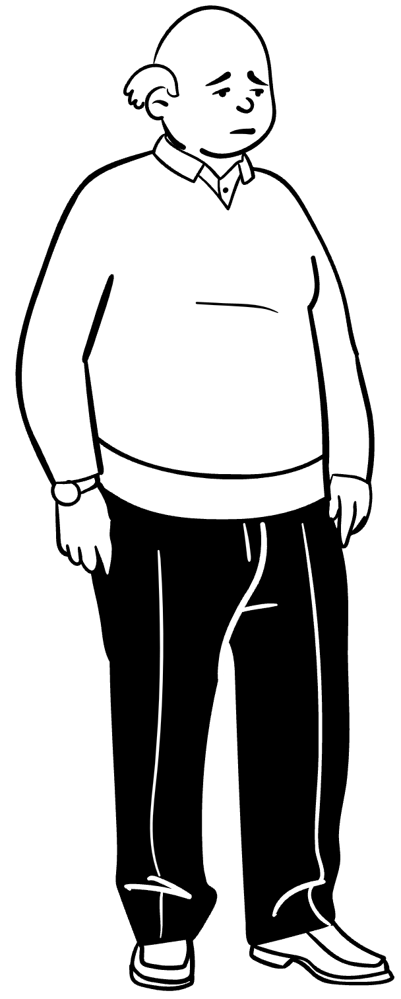
Health issues which increase falls risk?
Senses
Visual impairment: cataracts, macro-degeneration, poor glasses.
Auditory issues: inner ear problems affecting balance
Nervous System
Cognitive impairment: delirium and/or dementia
Neurological conditions: Stroke, Parkinson’s, peripheral neuropathy
Psychological: fear of falling
Respiratory
Breathlessness on exertion, poor O2 levels
Urinary and GI
Bladder and bowel dysfunction
Incontinence, constipation, infection
Cardiovascular
Cardiac disease: arrythmias, aortic stenosis -
Postural hypotension & syncope
Musculo-Skeletal
Postural instability: lower limb weakness, gait, joint disease
foot problems, poor footwear
Medical History and conditions
Acute illness
Underlying health conditions exacerbation/deterioration
History of falls: causes, fear of further falls
Medications
Poly-pharmacy – 4 or more medications
Particularly psychotropics and sedatives
Age
Notes:
Take 10 minutes to reflect on contributory factors under each of the headings
Multifactorial assessment should identify the patient's individual risk factors for falling in hospital SIGN guidelines
Any identified risks should be treated, improved or managed during their expected stay. These may include:
The more contributory factors an individual has, the greater the risk of a fall with associated harm.
Serious injury e.g. hip fracture may occur if the individual also has osteoporosis.
Use paper body maps with systems. Ask participants to consider what risk factors we assess for under each heading.. Answers come up system by system

Slide 33
Balance challenge
Stand up
Balance on one leg
we will aim for 30 seconds
Close your eyes
we will try the balance again for 30 seconds
Beside your chair
Notes:
We’d like you to join us in the balance challenge, if you feel steady enough
If you start to loose balance: put your other foot down or hold on to the chair.
This exercise highlights the affect of sight loss on our balance

Slide 34
Risk Management and Falls Prevention

Slide 35
‘It takes a child one year to acquire independent movement and ten years to acquire independent mobility. An old person can lose both in a day’
Professor Bernard Isaacs (1924–1995)
Notes:
Keeping still isn’t a falls prevention method, it can contribute to long term reduced mobility

Slide 36
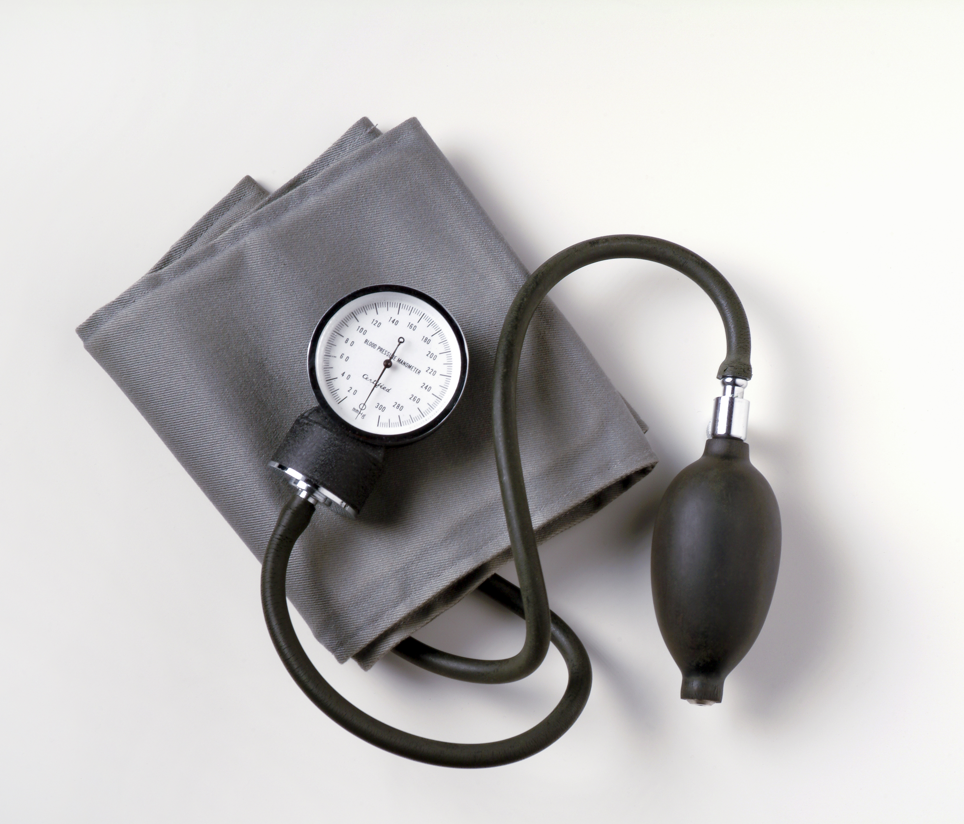
Risk management and falls prevention
Patients identified at risk of falling should have a multidisciplinary assessment and intervention bundle completed and documented management plan completed.
Some risk factors may not be modifiable but should be identified and acknowledged.
Actions taken will vary from individual to individual depending on their risk factors.
Notes:
Risk assessment and nursing / multifactorial interventions should be employed to help reduce the risk of falling If the patient is identified as at risk of falls but also requires supervision to ensure safety it is appropriate to consider the patients individual needs and increase the frequency of care rounding to accommodate this. It may be necessary to provide supervision whilst the patient is in the toilet and/ or bathroom and this must be carried out whilst preserving their dignity and privacy as much as possible.
An assessment of patient’s capacity should be made in order to determine whether treatment should be carried out under the guidance of Adults with Incapacity Act and if uncertain, psychiatry advice should be sought. This is particularly important if considering the use of falls sensors, bed rails or wander guard. Staff can also refer to the Safe and Effective use of Bed Rails policy.

Slide 37
Cognitive impairment risk management
Patients who are confused are one of the largest groups of individuals at risk of falls within the hospital setting.
Confusion, whether acute or chronic, should be screened for using the 4AT, or if a fuller screening is required, a Mini-Mental State Examination (MMSE).
Establish a collateral history from carers and relatives to determine if the problem is acute or chronic.
It is important to ask:
Does the patient has a diagnosis of dementia?
Have the confused episodes occurred before and under what circumstances?
Patients with dementia or delirium are particularly vulnerable and can
become disorientated when in an unfamiliar environment
Be at increased risk of wandering.
Have poor safety awareness
Patients who are confused are one of the largest groups of individuals at risk of falls within the hospital setting.
Patients with dementia or delirium are particularly vulnerable and can
become disorientated when in an unfamiliar environment
Be at increased risk of wandering.
Have poor safety awareness
Confusion, whether acute or chronic, should be screened for using the 4AT, or if a fuller screening is required, a Mini-Mental State Examination (MMSE).
Establish a collateral history from carers and relatives to determine if the problem is acute or chronic.
It is important to ask:
Does the patient has a diagnosis of dementia?
Have the confused episodes occurred before and under what circumstances?
These individuals require careful management with regular orientation and nursing in a well-lit environment.
Notes:
If the patient requires supervision to ensure safety it is appropriate to increase the frequency of care rounding

Slide 38
Delirium and falls
What is Delirium?
Delirium – one of the most common signs of deterioration in frail older adults
These are the most common causes in older people but can you think of any others?
Can last days/weeks/months
Can be hypoactive or hyperactive or mixed
Falls – may present to A&E/OOH/GP with a fall
A fall may be the first sign of a delirium or a consequence of a worsening one
Notes:
This might sit with HEALTH

Slide 39
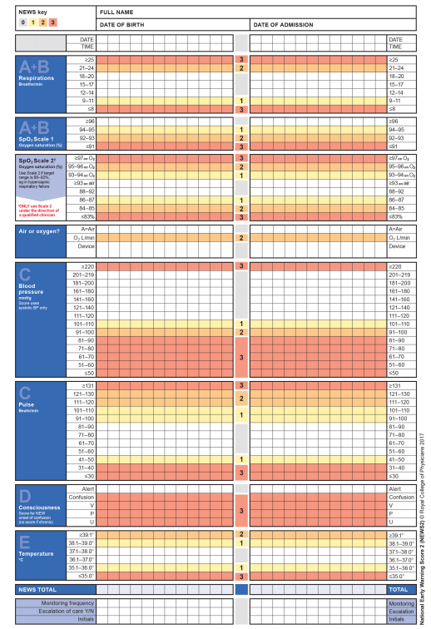
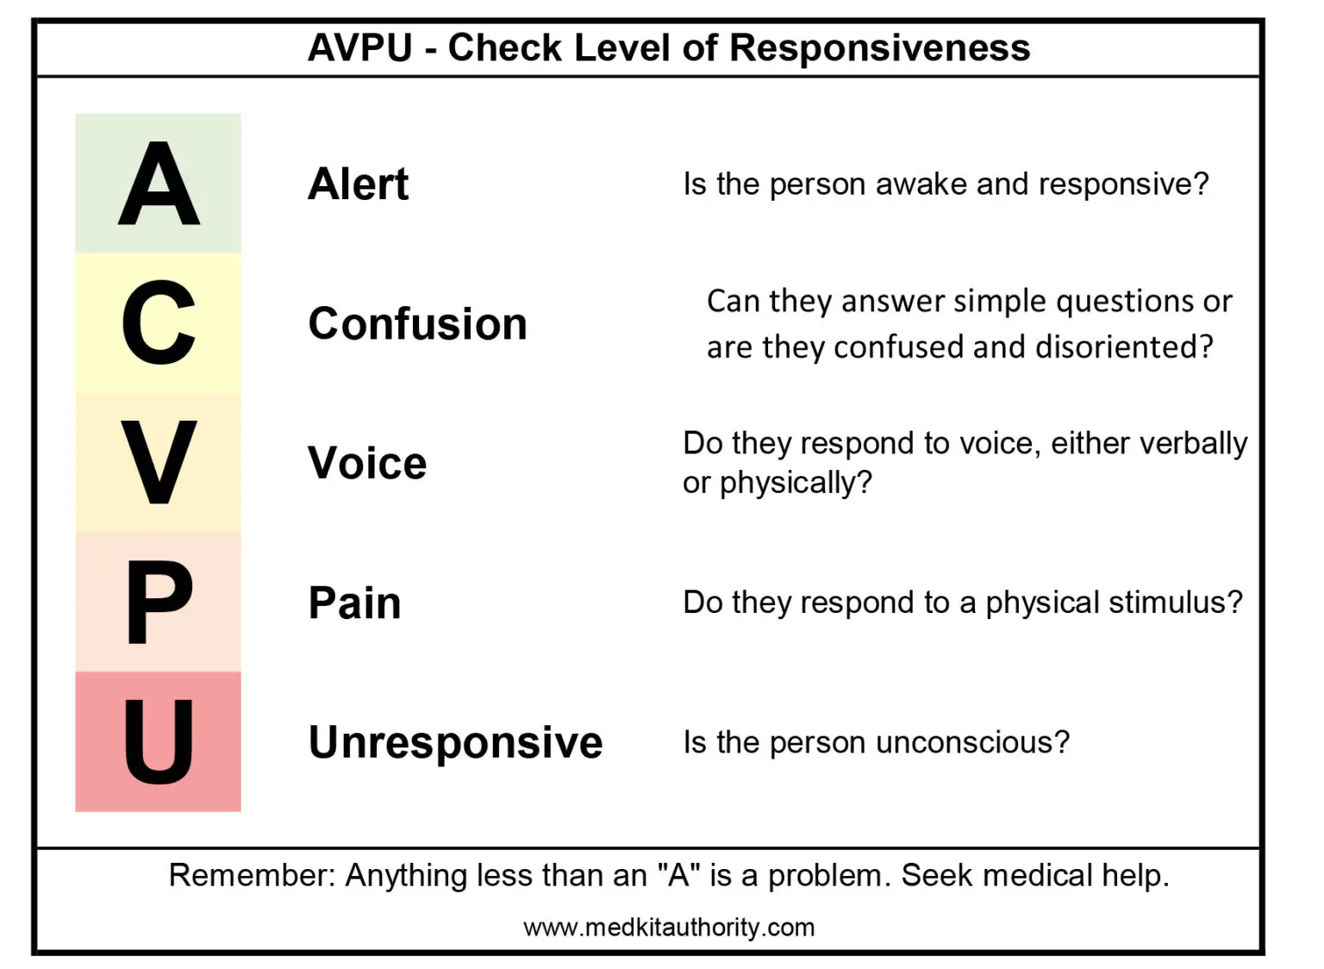
Delirium and falls
SQiD: single question in delirium
“Is this person more confused or drowsy lately?”
Consider NEW CONFUSION as an indicator of deteriorating health
With an increased risk of falls
Notes:
This might sit with assessment

Slide 40
Falls as a sign of clinical deterioration
It is recognised that acute illness in older people can lead to worsening of gait problems, increased confusion and unsteadiness.
On occasion, a fall may be the only presenting feature of such an acute illness.
A fall in hospital may be the first sign that a patient has acutely deteriorated.
The interaction between risk factors is complex and a multidisciplinary review to address prevention is required (NHS Lothian 2017)

Slide 41
Acute illness risk management
For patients admitted due to a fall or collapse, or who have a history of falls, first line management requires a medical review in order to establish whether there is an acute illness.
This will include a history, full physical examination and medication review.
Common underlying causes include:
Delirium
Infection
Sepsis
Syncope
Treatment of acute illness will contribute to reducing falls risk
Notes:
Active treatment and investigation of any cardiac problems such as arrhythmia is important if syncope is suspected as the cause for the fall.

Slide 42
Long term medical conditions risk management
Medical problems should be considered, particularly in patients who are unable to communicate the source of their distress
Constipation
Urinary incontinence
Pain
Osteoporosis
Postural Hypotension
Neurological disease
Corrective treatment or management of medical issues contributes to effective risk management of falls.
Notes:
If osteoporosis is suspected (e.g. previous history of fracture or obvious spinal vertebral deformity such as kyphosis) DEXA scanning and bone protection therapy should be considered.
Treatment of specific neurological or joint disease (where possible).
A medication review is also vital if the patient is found to have significant postural hypotension (defined as a drop of 20mmHg or more in systolic BP +/ minus a drop of 10mmHg in diastolic). BP measurements should be repeated if patients experience light-headedness on standing, as blood pressure varies throughout the day. Culprit medications should be reviewed and it may be appropriate to withhold them until the patient improves or discontinue altogether. There should be a documented plan of care for any multidisciplinary assessment and intervention within the patient’s record.

Slide 43
Medications risk management
Anti-coagulants
Sedation
Anti-hypertensives
Notes:
Anticoagulation with heparin or warfarin may not be safe in an individual with recurrent falls, particularly if they sustain a head injury. Ward teams should seek pharmacist’s advice.
Sedatives should be avoided if possible as they often worsen unsteadiness and can cause paradoxical agitation.
A medication review is also vital if the patient is found to have significant postural hypotension (defined as a drop of 20mmHg or more in systolic BP +/ minus a drop of 10mmHg in diastolic). BP measurements should be repeated if patients experience light-headedness on standing, as blood pressure varies throughout the day. Culprit medications should be reviewed and it may be appropriate to withhold them until the patient improves or discontinue altogether. There should be a documented plan of care for any multidisciplinary assessment and intervention within the patient’s record.

Slide 44
Optimising safe independent mobility risk management
Physiotherapy
Occupational therapy
Podiatry
Ophthalmology
Audiology
Multidisciplinary and multifactorial interventions should be employed to help reduce the risk of falling
Notes:
Physiotherapists assess gait, posture and mobility aids, and provide strength and balance training. Exercise programmes have been found to be the most effective interventions in randomised controlled trials and ones targeting these specific areas e.g. OTAGO strength and retraining programme should be prescribed. Staff should ensure that the patient is as mobile as possible according to management plan
Occupational therapists assess risk of falls and environmental hazards when engaging in everyday functional tasks with patients e.g. transfers and personal care. If problems are identified appropriate modifications and equipment can be provided.
Ensure patients have appropriate footwear and access to podiatry
Vision corrected: If reversible visual problems are suspected such as poor glass prescriptions, or cataracts then an ophthalmology review may be indicated.

Slide 45
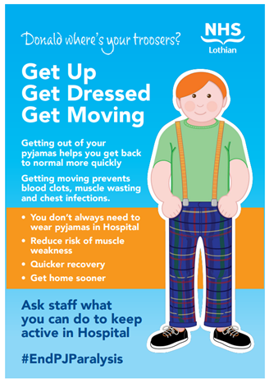
End PJ Paralysis
Get Up, Get Dressed, Get Moving

Slide 46
Equipment and Environment risk management
Bedrails
Mobility aids
Footwear
Bed space
Notes:
In order to reduce the risk of injury, the bed can be lowered nearer the floor.
Assessment of capacity should be made to determine whether treatment should be carried out under the guidance of Adults with Incapacity Act (if uncertain, psychiatry advice should be sought.)
This is particularly important if considering the use of falls sensors, bed rails or wander guard.
Staff can also refer to the Safe and Effective use of Bed Rails policy.

Slide 47
Communication risk management
Safety brief
Care planning
Documentation
family
Notes:
Patients who are identified as at risk of falling require to be identified at the ward safety brief and may be escalated at the site safety huddle.
A safety bundle should be initiated and a person centred plan of care completed with input from the patient, and if appropriate, their relatives.
Falls prevention information should be provided on admission and relatives / carers encouraged to actively participate in minimising the risk of falls
Information should be provided about the process of risk assessment and management to relatives and carers. A leaflet is available for this purpose for inpatients and written information should be displayed on the wards
Patients and families should take an active role in care planning to ensure that it is person centred
Use of the “Getting to know me” document will help to provide useful personal information for staff to provide person centred care.

Slide 48
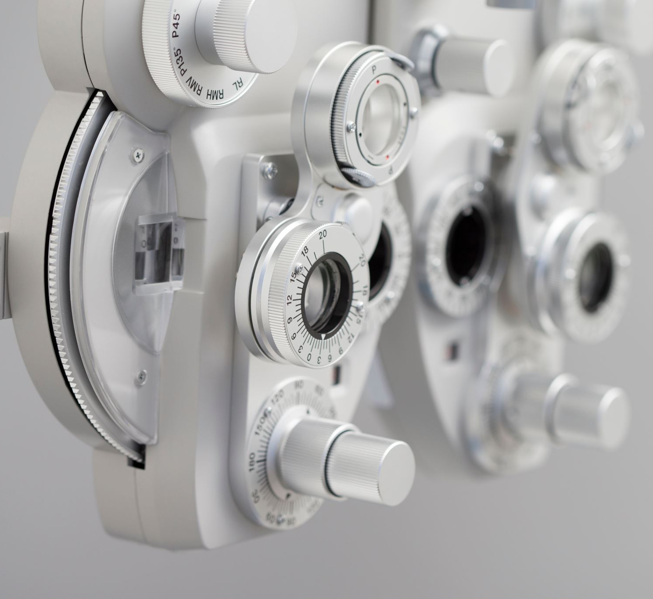
Management NICE 2013
In successful multi-factorial intervention programmes the following specific components are common (against a background of the general diagnosis and management of causes and recognised risk factors):
strength and balance training
home hazard assessment and intervention
vision assessment and referral
medication review with modification/withdrawal

Slide 49
When patients require enhanced care interventions

Slide 50
Falls sensors
Falls sensor patient leaflet (scot.nhs.uk)
Falls Sensor Guidelines v4 (scot.nhs.uk)

Slide 51
Patients requiring increased supervision
If the person is showing signs of stress or distress then a systematic approach to identify the cause is recommended to help identify possible trigger. Challenging behaviour – a systematic approach to assessment
An increased risk of falls may require the person to be placed in an observable area e.g. near the nurses’ station.
A consideration may be to co-hort the person into a multi-bedded room and ensure that a member of staff is always present to assist
1:1 CARE
All other alternatives should be considered before requesting 1:1 observation. Please see (Appendix 5) Page 9 of 19
If 1:1 care is provided then an hourly summary of the person’s presentation must be recorded.
1:1 care should be assessed every 24 hours by the multi-disciplinary team (if possible) and stepped down as soon as the person’s safety has improved

Slide 52
Capacity
But what about people who lack capacity?
What people might not have capacity to make their own decisions?
What legal act do we use for these people?

Slide 53
Assessment of Capacity
Assessment of Capacity should be completed to determine whether treatment should be carried out under the guidance of Adults with Incapacity Act.
if uncertain, psychiatry advice should be sought.
This is particularly important if considering the use of falls sensors, bed rails or wander guard.
Staff can also refer to the Safe and Effective use of Bed Rails policy.

Slide 54
Adults with Incapacity Act 2000
The Act aims to protect people who lack capacity to make particular decisions, but also to support their involvement in making decisions about their own lives as far as they are able to do so.
Anyone authorised to make decisions or take actions on behalf of someone with impaired capacity must apply the following principles….

Slide 55
Adults with Incapacity Act 2000
Principle 1
Principle 2
Principle 3
Principle 4
Principle 5
Benefit
Least-restrictive option
Take account of the wishes of the person
Consultation with relevant others
Encourage the person to use existing skills and develop new skills

Slide 56
Adults with Incapacity Act 2000
Any action or decision taken should be the minimum necessary to achieve the purpose. It should be
The option that restricts the person's freedom as little as possible.
Any action or decision taken must benefit the person, and only be taken when that benefit cannot
reasonably be achieved without it.
Any action or decision taken should be the minimum necessary to achieve the purpose. It should be
The option that restricts the person's freedom as little as possible.
In deciding if an action or decision is to be made, and what that should be, account must be taken of the
present and past wishes and feelings of the person as far as these may be understood
Take account of the views of others with an interest in the person's welfare. The Act lists those
who should be consulted whenever practicable and reasonable. It includes the person's primary
carer, nearest relative, named person, attorney, or guardian, if there is one
Encouraging and allowing the adult to make their own decisions and manage their own affairs and,
as much as possible, to develop the skills needed to do so

Slide 57
Complaints
Investigation Report 201404874 | Highland NHS Board | SPSO
Investigation Report 201403146 | Lothian NHS Board | SPSO
Investigation Report 201306190 | Borders NHS Board | SPSO
Investigation Report 201204018 | Lothian NHS Board | SPSO
Investigation Report 201202679 | Fife NHS Board | SPSO
Notes:
Summary of info for each report to be added here.

Slide 58
Post Fall Assessment and Care

Slide 59
Management of a fall: Post Falls bundle
The person should not be moved until they have been checked for signs and symptoms of fracture or potential spinal injury. The top to toe assessment should be completed and documented
Safe manual handling methods must be used if there are any signs and symptoms of fracture or potential for spinal injury
Where head injury has occurred or cannot be excluded (e.g. unwitnessed fall) neurological observations must be recorded and the frequency and duration documented, based on medical guidance
Medical examination should take place within agreed timescales following a fall especially those with a high vulnerability to injury, or who have been immobilised due to injury
Conduct a post fall review / rapid root cause analysis to learn how further falls can be prevented for the person and for wider learning

Slide 60
Post falls care
Assessment
by the staff member witnessing the fall
IS THE PERSON:
Unresponsive: check airway > signs of life?
No signs of life: call cardiac arrest team > start CPR
Responsive? ask about pain > assess for injury, consider first aid
ABCDE Assessment prior to moving
Top-to-toe assessment for injury by nursing staff (where competent) or Dr
Assess the environment, is it safe?
NB spinal injury caution > Advice re spinal board
Consider how to best get the person off the floor.
All falls should be reported to Medical staff at time
of incident

Slide 61
Ongoing care
Is Head injury suspected or Unwitnessed fall? > Neuro observations immediately > GCS out of 15 > inform Dr
Dr should review pt ASAP, particularly where injury is evident/nurse has concerns
Where top-to-toe has be carried out and no injury noted, Dr review should still be within 12 hours, if deemed safe.
Falls risk assessment should be carried out and care plan updated.
Note falls risk above bed space
Information about falls risks should be discussed with patient and relatives

Slide 62
Communication and Documentation following fall
Next of kin informed ASAP of the situation
Assessment outcome documented in patients notes
Where serious injury is sustained consultant should also be informed
DATIX reporting
completed ASAP, incident number shared with charge nurse
Including details of circumstances of fall and actions taken.
All falls which involve harm are subject to incident investigation and if a fracture or death occurs they are reviewed by senior management teams. This is important to ensure safety and enable reflective practice so that lessons may be learned.

Slide 63
Scenario

Slide 64
Summary
Reducing falls risks is a healthcare priority
We can improve outcomes through risk management and falls prevention, using an MDT approach.
Ensuring the falls pathway becomes embedded in practice will support this.

Slide 65
Next steps
How will you set about reducing falls risk in your area?
Any questions for us?
Further clarification needed?
Materials, including presentation and handouts, will be available on the falls intranet pages

Slide 66
Statistics and health care priorities
Falls and why they happen
Assessing falls risk
Improving outcomes through risk management and falls prevention interventions
Enhanced measures
Post falls assessment and care
Contents

Slide 68
References & Resources
Policy and Protocol for the Assessment and Management of Adult Hospital Patients with Falls (nhslothian.scot)
NAIF annual report 2023 | RCP London
World guidelines for falls prevention and management for older adults: a global initiative | Age and Ageing | Oxford Academic (oup.com)
Overview | Falls in older people: assessing risk and prevention | Guidance | NICE
Breast Care Nurse Service (scot.nhs.uk) (falls sensor leaflet – no idea why it says this!!)
Falls Sensor Guidelines v4 (scot.nhs.uk)
Jacqueline C T Close, Stephen R Lord, Fall prevention in older people: past, present and future, Age and Ageing, Volume 51, Issue 6, June 2022, afac105, https://doi.org/10.1093/ageing/afac105
Ambition 4. Target more specialist, personalised care and support - National falls and fracture prevention strategy 2019-2024 draft: consultation - gov.scot (www.gov.scot)

