Slide 1

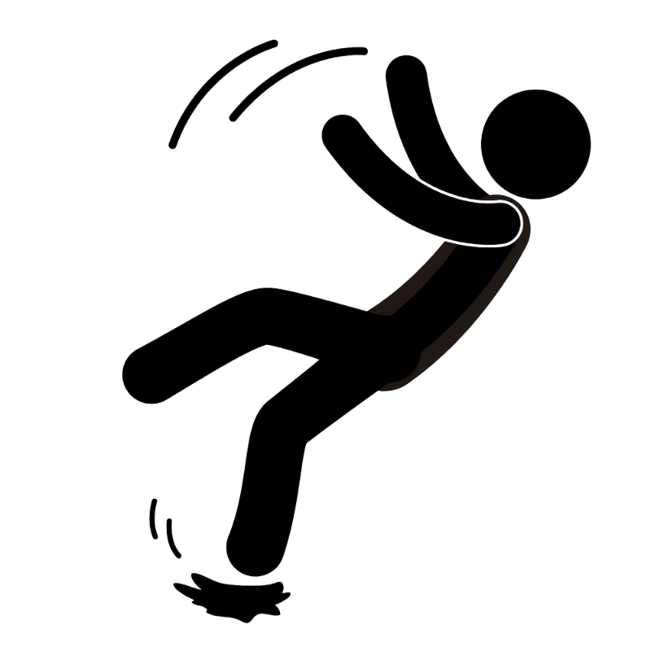

Reducing Avoidable Harm through Falls Prevention
Development of a Falls Prevention and Management Pathway
Notes:
Hello, my name is Hannah Cairns, and I work for Edinburgh Health and Social Care Partnership as the Chief Allied Health Professional.
It is my pleasure to share with you the output of over 18 months of work to improve the outcomes of people living in the community in Edinburgh at risk of falls.

Slide 2
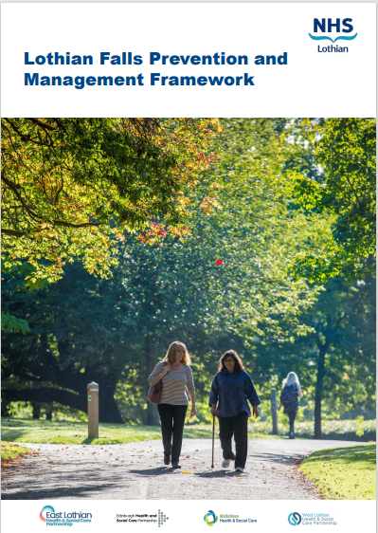
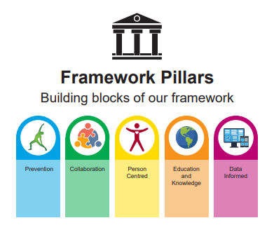
Notes:
The work we've carried out in Edinburgh has played a key role in supporting the implementation of the Lothian Falls Prevention and Management Framework, which, as many of you will know, was published earlier this year. This framework has been instrumental in guiding our approach, providing us with a clear and consistent strategic direction across services. It sets out priorities for action, promotes evidence-based practice, and supports a more integrated and preventative approach to falls management across the region.
By aligning our work in Edinburgh with the aims of the framework, we've been able to contribute meaningfully to its early progress, helping to embed its principles into local practice and begin addressing some of the key challenges around falls prevention in a more coordinated way

Slide 3
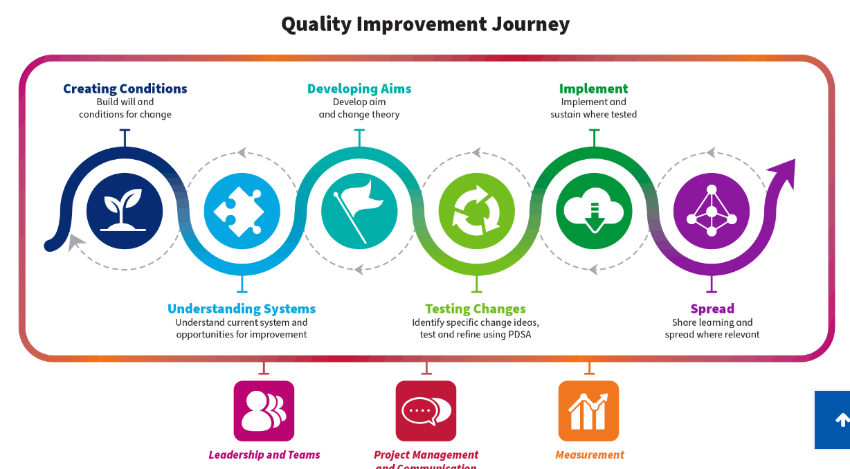
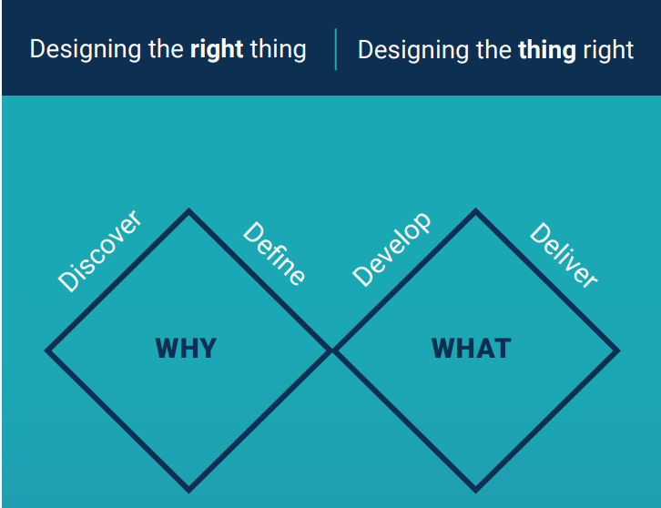
Notes:
We developed this work using Quality Improvement methodology alongside the Scottish Approach to Service Design, which many of you may know as the 'double diamond' approach. Using these structured methods has been key to the project’s success. It’s important to highlight that they allowed the team to take a step back and fully explore the challenges within the system before moving towards solutions. This meant we could clearly identify the areas that needed to be addressed, based on real insight and evidence, rather than assumptions.

Slide 4
Case for Change
Falls are one of the most expensive yet largely avoidable challenges impacting the health and social care system. The cost of falls is significant both financially and on the physical, psychological and functional outcomes of people.
In Edinburgh, many services contribute to the management and prevention of falls however it is recognised that the approaches adopted are often low priority, highly variable and unreliable.
At present approximately 120 people per week present to ED because of a fall, of those around 20 are admitted with a fractured neck of femur [each of which is estimated to cost between £56-72k for health costs alone] putting pressure on in demand unscheduled care services
Notes:
Falls represent one of the most costly — yet largely preventable — challenges facing our health and social care system. The impact is not only financial, but also deeply affects individuals’ physical, psychological, and functional wellbeing.
In Edinburgh, we know that many services are involved in falls prevention and management. However, the current approach tends to be low priority, inconsistent, and often unreliable.
Right now, around 120 people attend the Emergency Department each week due to a fall. Of those, approximately 20 are admitted with a fractured neck of femur — each case costing the health service between £56,000 and £72,000. This places significant strain on already stretched unscheduled care services.

Slide 5
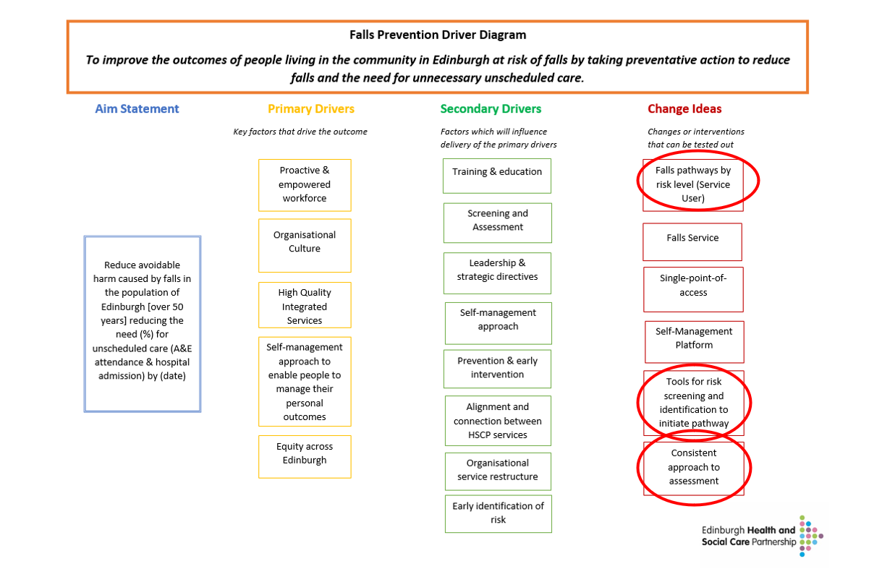
Notes:
Over time, the falls project team carefully developed their approach, which is outlined in this driver diagram. At the heart of the work is a clear and ambitious goal: to reduce avoidable harm from falls by 30% within the first 12 months of implementing the new approach.
To achieve this, we focused on three key change ideas:
First, we planned to introduce a risk stratification model, which allowed us to develop clear falls risk levels and corresponding care pathways.
Second, we planned to design a screening tool to help identify individuals at risk of falling early and consistently.
And third, we planned to create a standardised approach to assessing those at highest risk, ensuring they receive the right support at the right time.

Slide 6
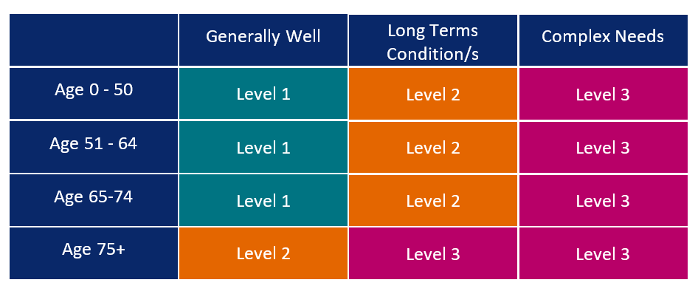
Risk Stratification Matrix
Notes:
The first step in our approach was to develop and test a risk stratification model for falls, grounded in a population health perspective.
We started by creating a theoretical model that stratified individuals based on age and overall wellbeing. This formed the basis of our initial risk framework, which we then took forward for testing to see how well it worked in practice.
The goal here was to move from a one-size-fits-all approach to one that allows us to better understand who is most at risk—and to tailor support accordingly.

Slide 7
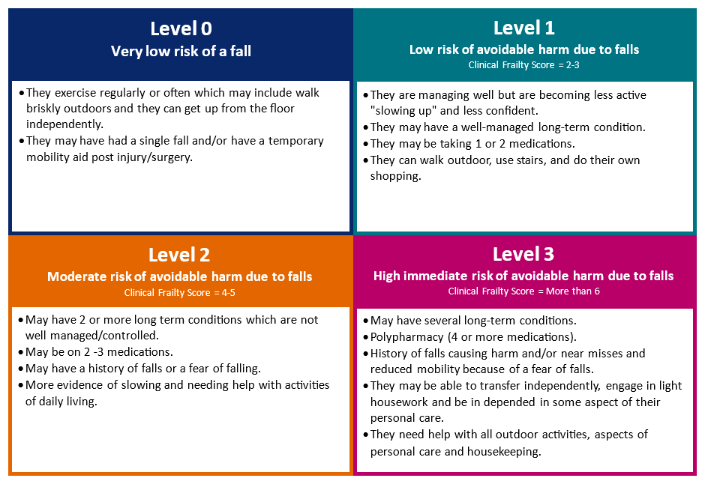
Falls Risk Stratification Levels
Notes:
As we tested the risk model across a variety of settings, something important emerged: we identified an additional group—those at very low risk of falls, which we’ve now defined as ‘risk level 0’.
It became clear that this group needed to be recognised in the model. While they may not need specific intervention, it’s still important to provide appropriate support—so we focused on public health messaging and signposting to help them maintain their wellbeing and prevent future risk.
As a result of this work, we were able to confirm four distinct falls risk levels. These are: Level 0 – very low risk, Level 1 – low risk, Level 2 – medium risk, and Level 3 – high risk.
This stepped approach gives us a clearer framework for identifying individuals' risk and tailoring the right support to the right people.

Slide 8
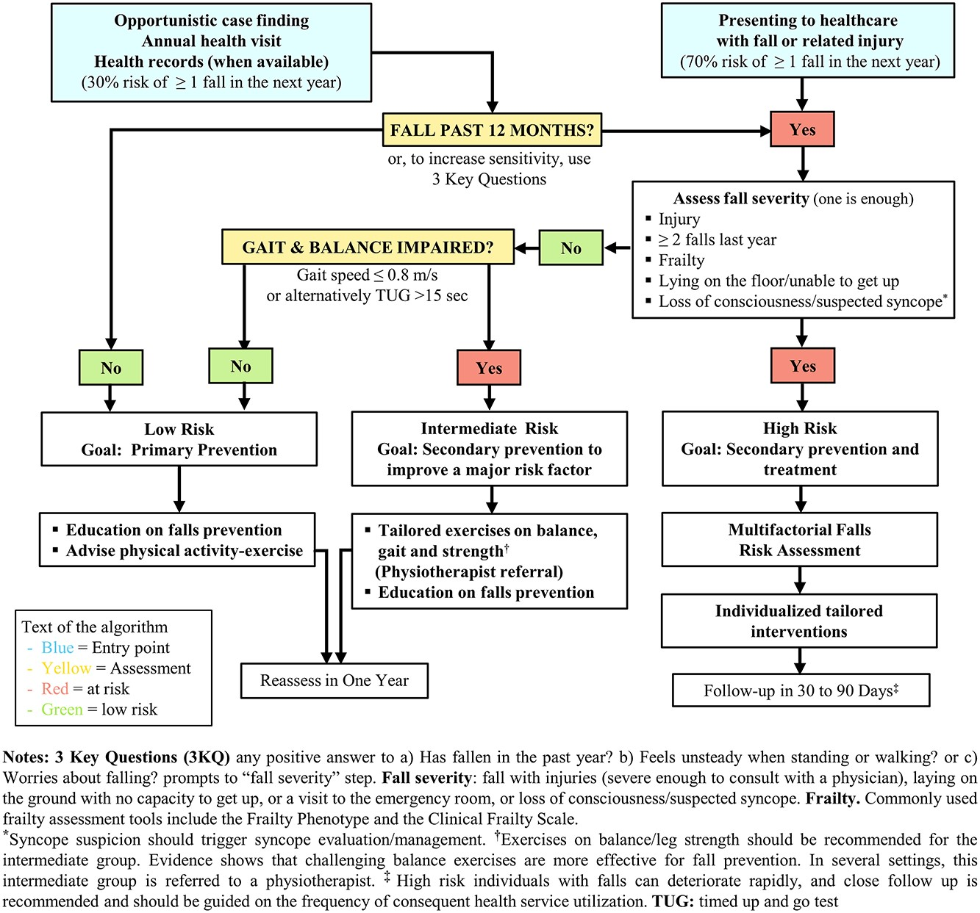

World Falls Algorithm
Notes:
As part of the development process, the team paid close attention to the World Falls Algorithm and carefully considered how it could align with our own tested risk stratification model.
The final screening tool we developed is a blend of both—bringing together elements of the World Falls approach with our local insights. We believe this combination offers the most appropriate and effective way to identify and support people at risk of falls here in Edinburgh.

Slide 9
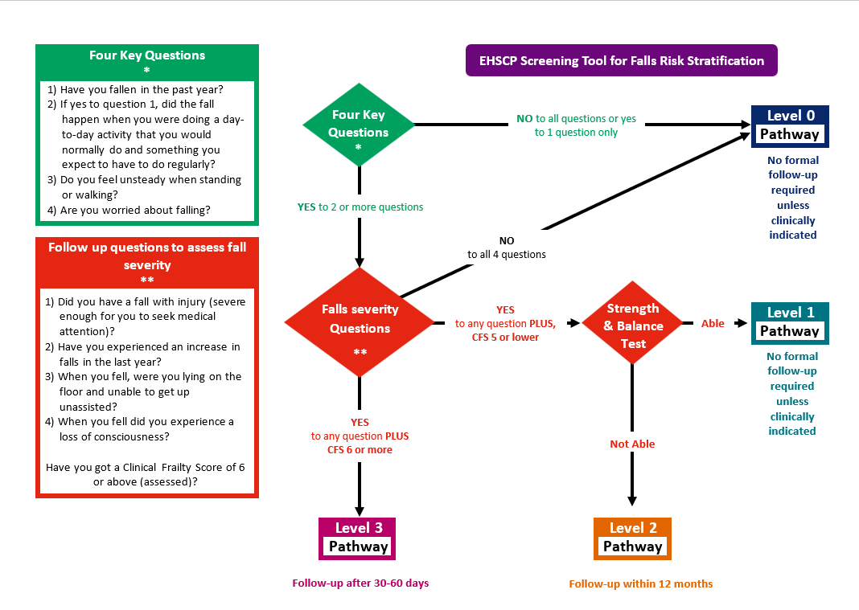
Notes:
This work led to the design and development of a new Falls Screening and Identification Tool, which can be used by a wide range of health and care professionals across the system.
The tool allows us to identify individuals at risk of falling and categorise them in a consistent and structured way, based on their level of risk.
After completing the screening, individuals are assigned to one of four risk levels—starting with Level 0 for very low risk, then Level 1 for low risk, Level 2 for moderate risk, and Level 3 for high risk.
This shared approach helps ensure everyone is assessed using the same clear framework, no matter where they present within the system.

Slide 10
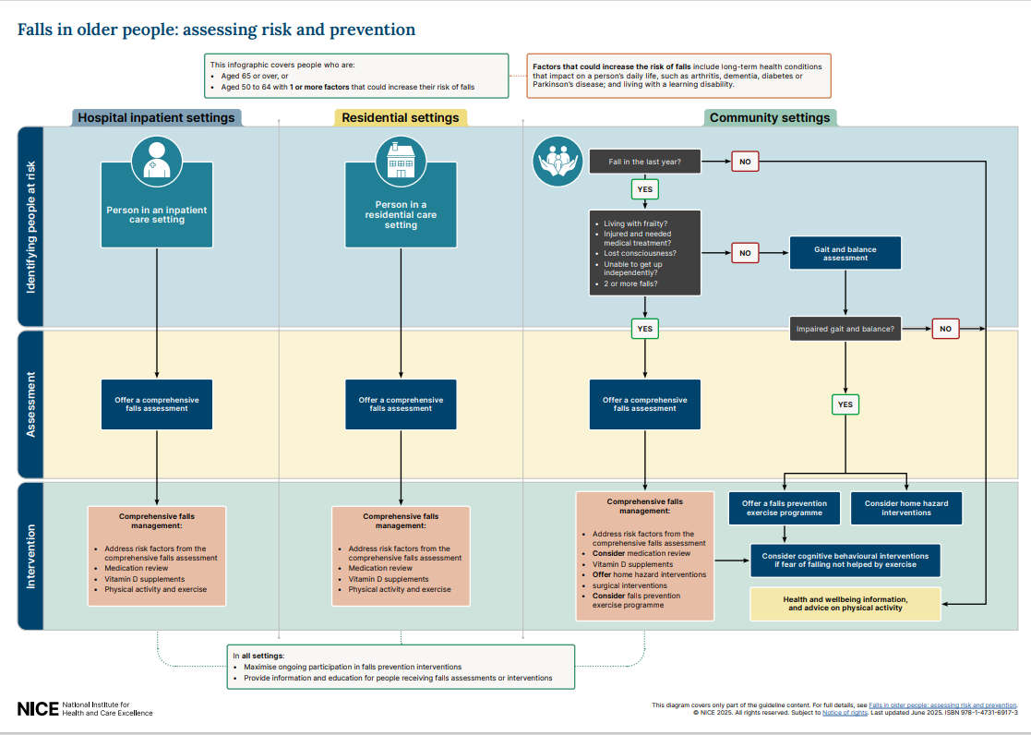
Notes:
Earlier this year, the updated NICE guidelines on falls in older people were published. We were really pleased to see that the approach we had developed was already fully aligned with these national recommendations.
It was reassuring to know that no changes were needed, and that our work is not only evidence-based but also reflects best practice at a national level.

Slide 11
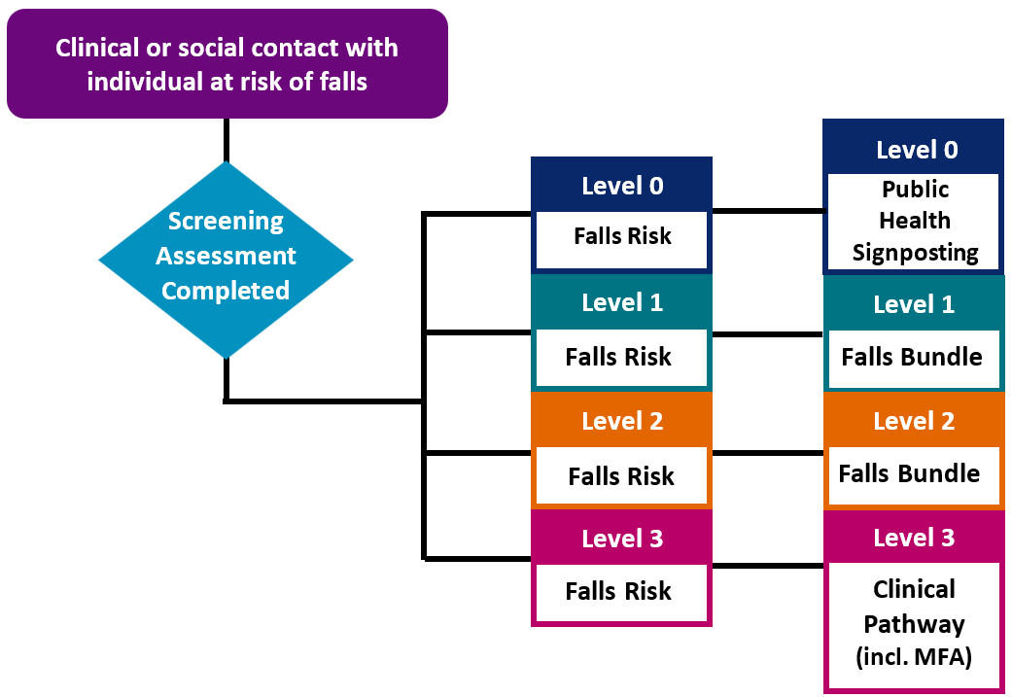
Notes:
Once we’ve identified individuals based on their level of falls risk, we’ve put in place targeted Care Bundles designed to match that risk. These bundles help ensure people get consistent support, that preventative steps are taken as early as possible, and that we focus our limited resources where they’re needed most — with those at the highest risk.

Slide 12
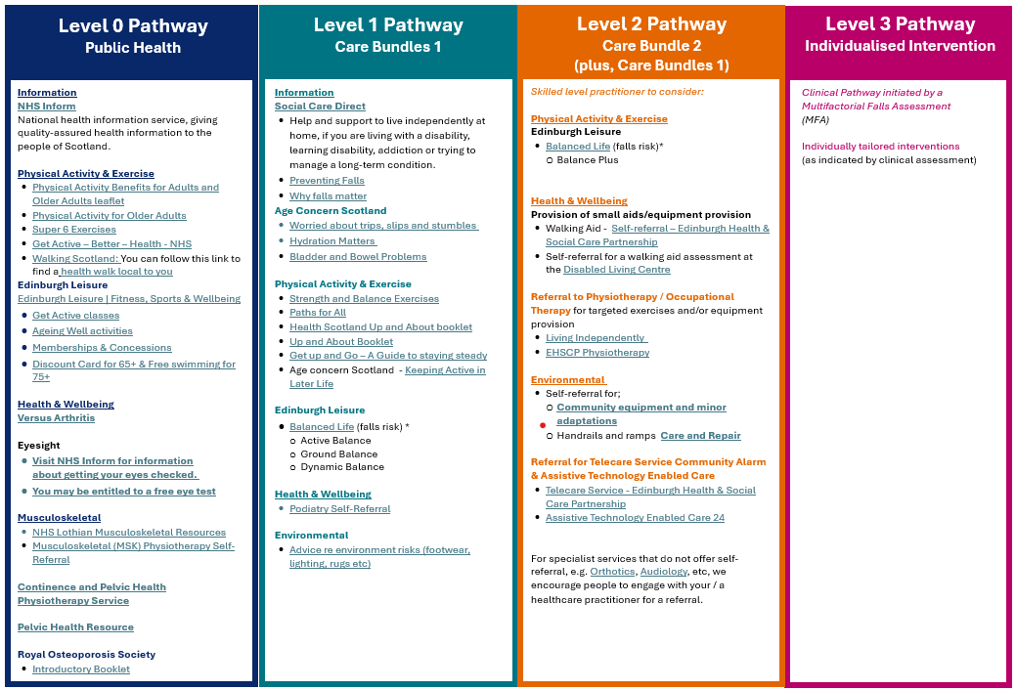
Falls Prevention & Management Care Bundles
Notes:
Detail of the care bundles can be seen here and are cumulative, starting at Level 0 with clear, clinically sound signposting to appropriate support. As we move to Levels 1 and 2, the approach becomes more focused, offering access to strength and balance programmes through our partners at Edinburgh Leisure as well as some more targeted support.
When someone is identified at Level 3 risk, they move to a clinical pathway and are offered a full multifactorial falls assessment. This is carried out by a trained Occupational Therapist or Physiotherapist, leading to tailored interventions based on their specific needs.

Slide 13

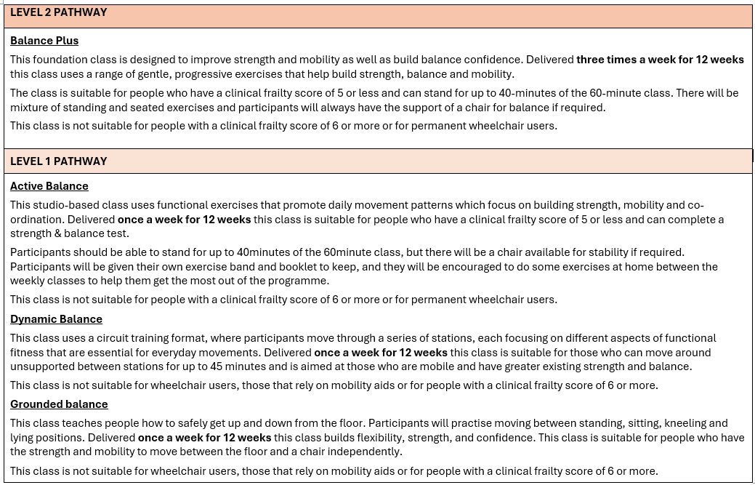
Commissioned Falls Prevention Classes
Notes:
Here, you'll find more detail about the strength, balance, and exercise programmes we’ve commissioned through our partnership with Edinburgh Leisure. These are now delivered under the Balanced Life programme, which has replaced the previous Steady Steps offering.
For individuals identified at risk level 2, the programme now includes a more intensive Balance Plus class, providing targeted support to help reduce their risk of falls.

Slide 14
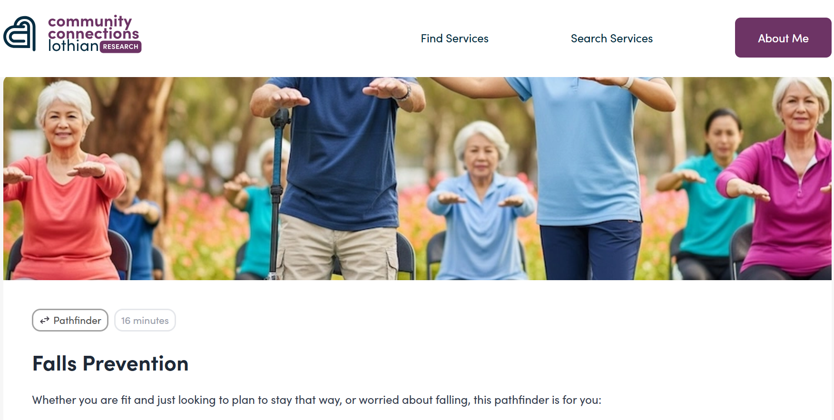
Falls Prevention Screening & Supported Self Management Tool
Notes:
When we developed our risk-stratified falls screening tool, we did so with a strong focus on self-management. The aim was to create a decision-making tool that individuals — along with their carers and families — could use themselves, guiding them through the pathway online and helping them access information that's tailored to their specific needs.
This self-management platform is a vital part of the support we offer to people at risk of falling. It empowers them to take an active role in managing their health, with the right information at the right time.

Slide 15
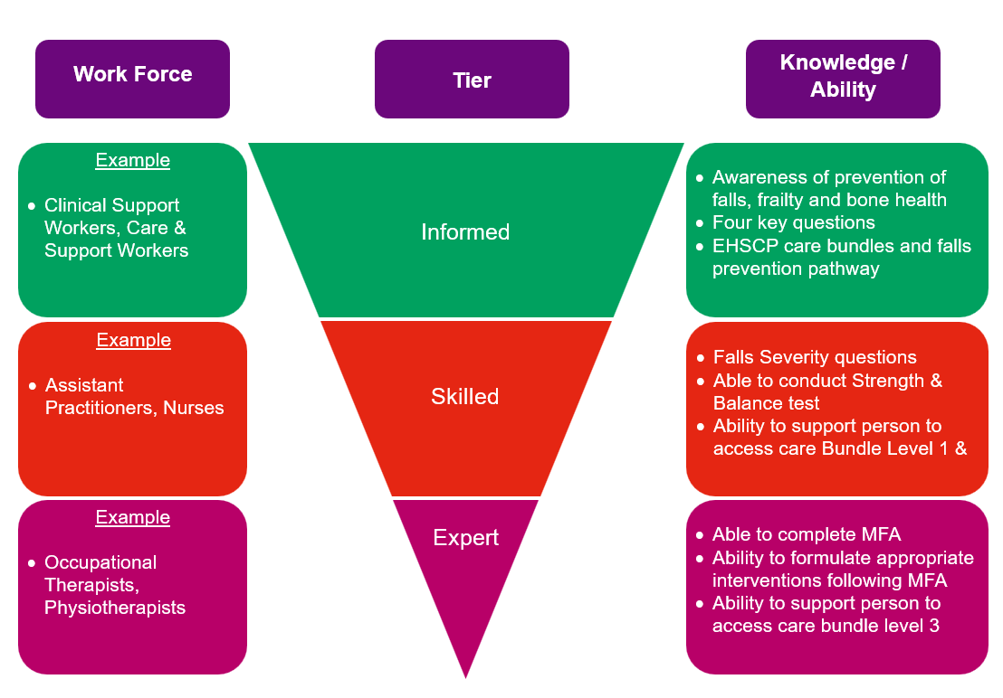
Falls Prevention & Management Knowledge and Skills Tiers
Notes:
To successfully implement the new falls prevention and management pathway, it's vital that we have a skilled workforce in place, with access to the right information at the right time.
That’s why we’ve developed a supporting knowledge and skills framework with three distinct tiers of expertise. This framework is designed to guide staff in building the necessary expertise, so they can deliver the pathway safely, effectively, and to the highest standard—within their own scope of practice.

Slide 16
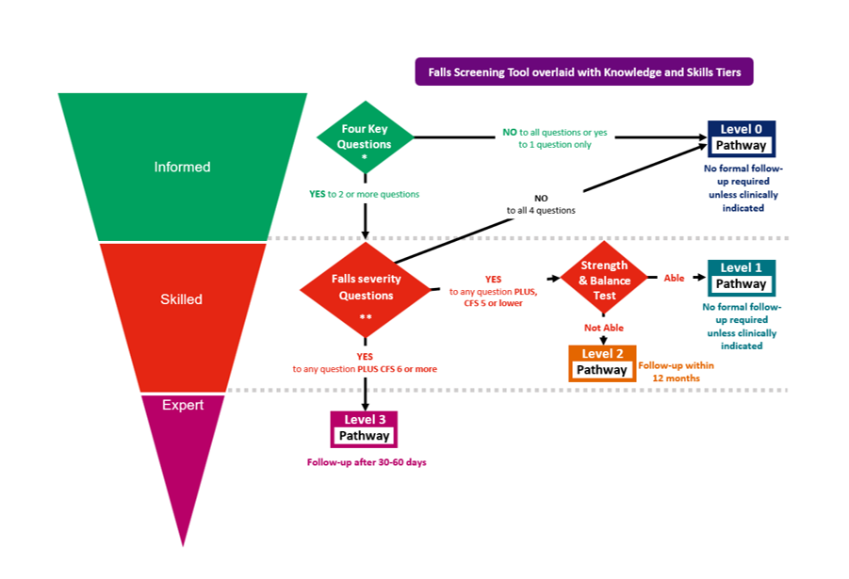
Falls Screening Tool with Knowledge and Skills Tiers
Notes:
This visual shows how our knowledge and skills tiers align with the falls screening tool.
At the Informed Tier, staff are equipped to safely carry out the first part of the screening tool. This level is designed for anyone who regularly interacts with people at risk of falling.
The Skilled Tier supports the second stage of the screening process, which includes falls severity questions, Clinical Frailty Scale (CFS) scoring, and basic strength and balance testing. This allows us to identify and differentiate individuals across risk levels 1 to 3.
Finally, the Expert Tier is for professionals responsible for delivering the clinical pathway. This is triggered by a multifactorial falls assessment and includes more advanced, targeted interventions.

Slide 17
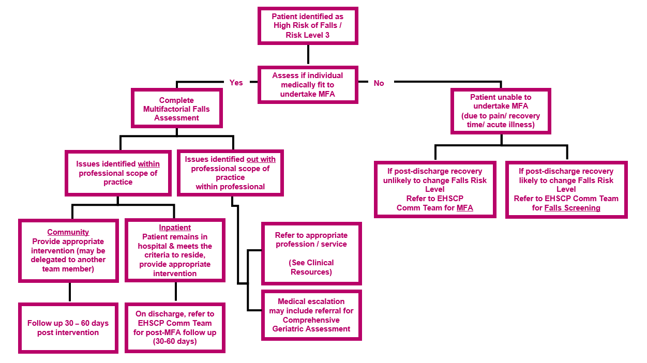
Level Three Clinical Pathway
Notes:
This slide outlines the clinical pathway, which is intended for use by clinicians working at the Expert Tier level.
The first step is to determine whether the individual is suitable to undergo a multifactorial falls assessment. From there, the clinician can identify the person’s specific needs, and the most appropriate support or interventions required to reduce their risk.

Slide 18
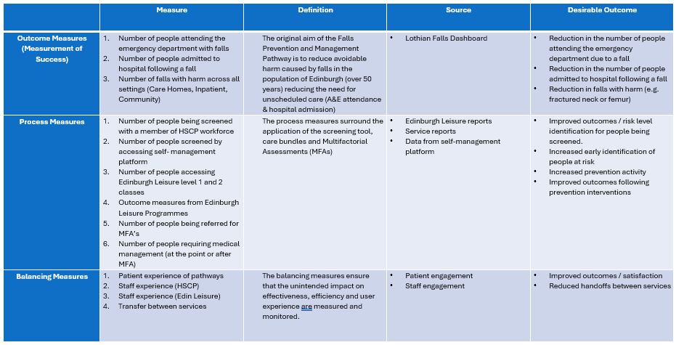
Pathway Measurement Plan
Notes:
We expect the new falls pathway to continue evolving and improving as it's embedded across the system.
To support this, we’ve developed and evaluated a new Clinical Lead for Falls role, and we hope to recruit into that post soon. This role will be central to overseeing the implementation of the pathway, measuring its impact, and driving ongoing improvements.
Our measurement framework is still in the early stages, but we anticipate it will develop further as we gather more data and insights from practice.

Slide 19
Thank you ☺
Notes:
I hope you’ve found this presentation helpful. It’s just one part of a wider toolkit designed to support you in implementing the falls pathway, no matter where you work within the health and care system.
Thank you for taking the time to listen.

